Slide 1
Claritin Sentiment Analysis
Presenter: Pankhjn & Mingming Hu
SCS 3253 005 Machine Learning

Slide 2
Agenda
Part1: Introduction
Part2: Data preparation
Part3:
Part4:
Part5:Conclusion

Slide 3
Part 1: INTRODUCTION
Definition of Claritin: is a combination of antihistamine and decongestant used to treat allergies, nasal congestion and sinus pressure.
Objective: Assign a Sentiment Score to the Claritin tweet
Hypothesis: Total negative score of Claritin Tweet outperform the side Effects reported by drug producing companies to FDA

Slide 4
Part2: DATA PREPAREATION
Data Set Characteristics: | Multivariate, Text | Number of Instances: | 4900 | Area: | Medicine, Healthcare
Attribute Characteristics | Categorical, Integer | Number of Attributes: | 17 | Date Donated: | Nov 13, 2013
Associated Tasks: | Classification, Clustering | Missing Values: | yes | Techniques: | NLP, Neural Network, SVM

Slide 5
The framework for NLP
Data Collection
Data preprocessing
Data Exploration & Visualization
Model Building

Slide 6
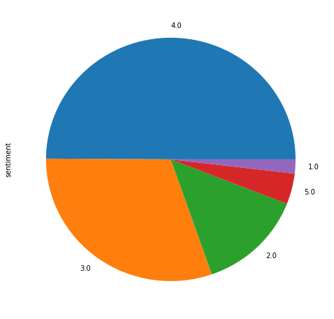
Step 1: Data Collection & Assembly
Data information: www.figure-eight.com/discovering-drug-side-effect-with-crowdsourcing/
Data source: www.figure-eight.com/data-for-everyone
Side effect variables: dizziness, convulsion, heart palpitations, shortness of breathe, headaches, drug effect decreased, allergies_after_drug, nausea, insomnia, bad interaction bw.
The value of them is yes or no.
The sentiment：1 means strong negative opinion and 5 means strong positive opinion.

Slide 7
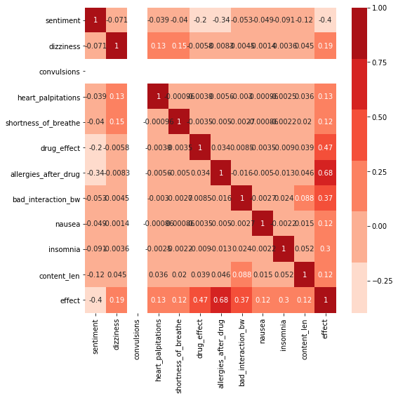
The relationship b/w sentiment and side effect
From the heat map we know that allergies after drug have -0.34 impact sentiment.

Slide 8
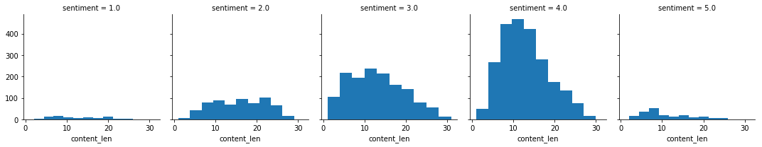
Create variable sentence word-- content_word: The more users estimate sentiment 4 and less users estimate sentiment 1 and 5.

Slide 9
Step 2:Data preprocessing
1. remove the emoji
2. remove the stopwords
3. replace consecutive non-ASCII characters with a space
4. remove http
5. tokenization

Slide 10
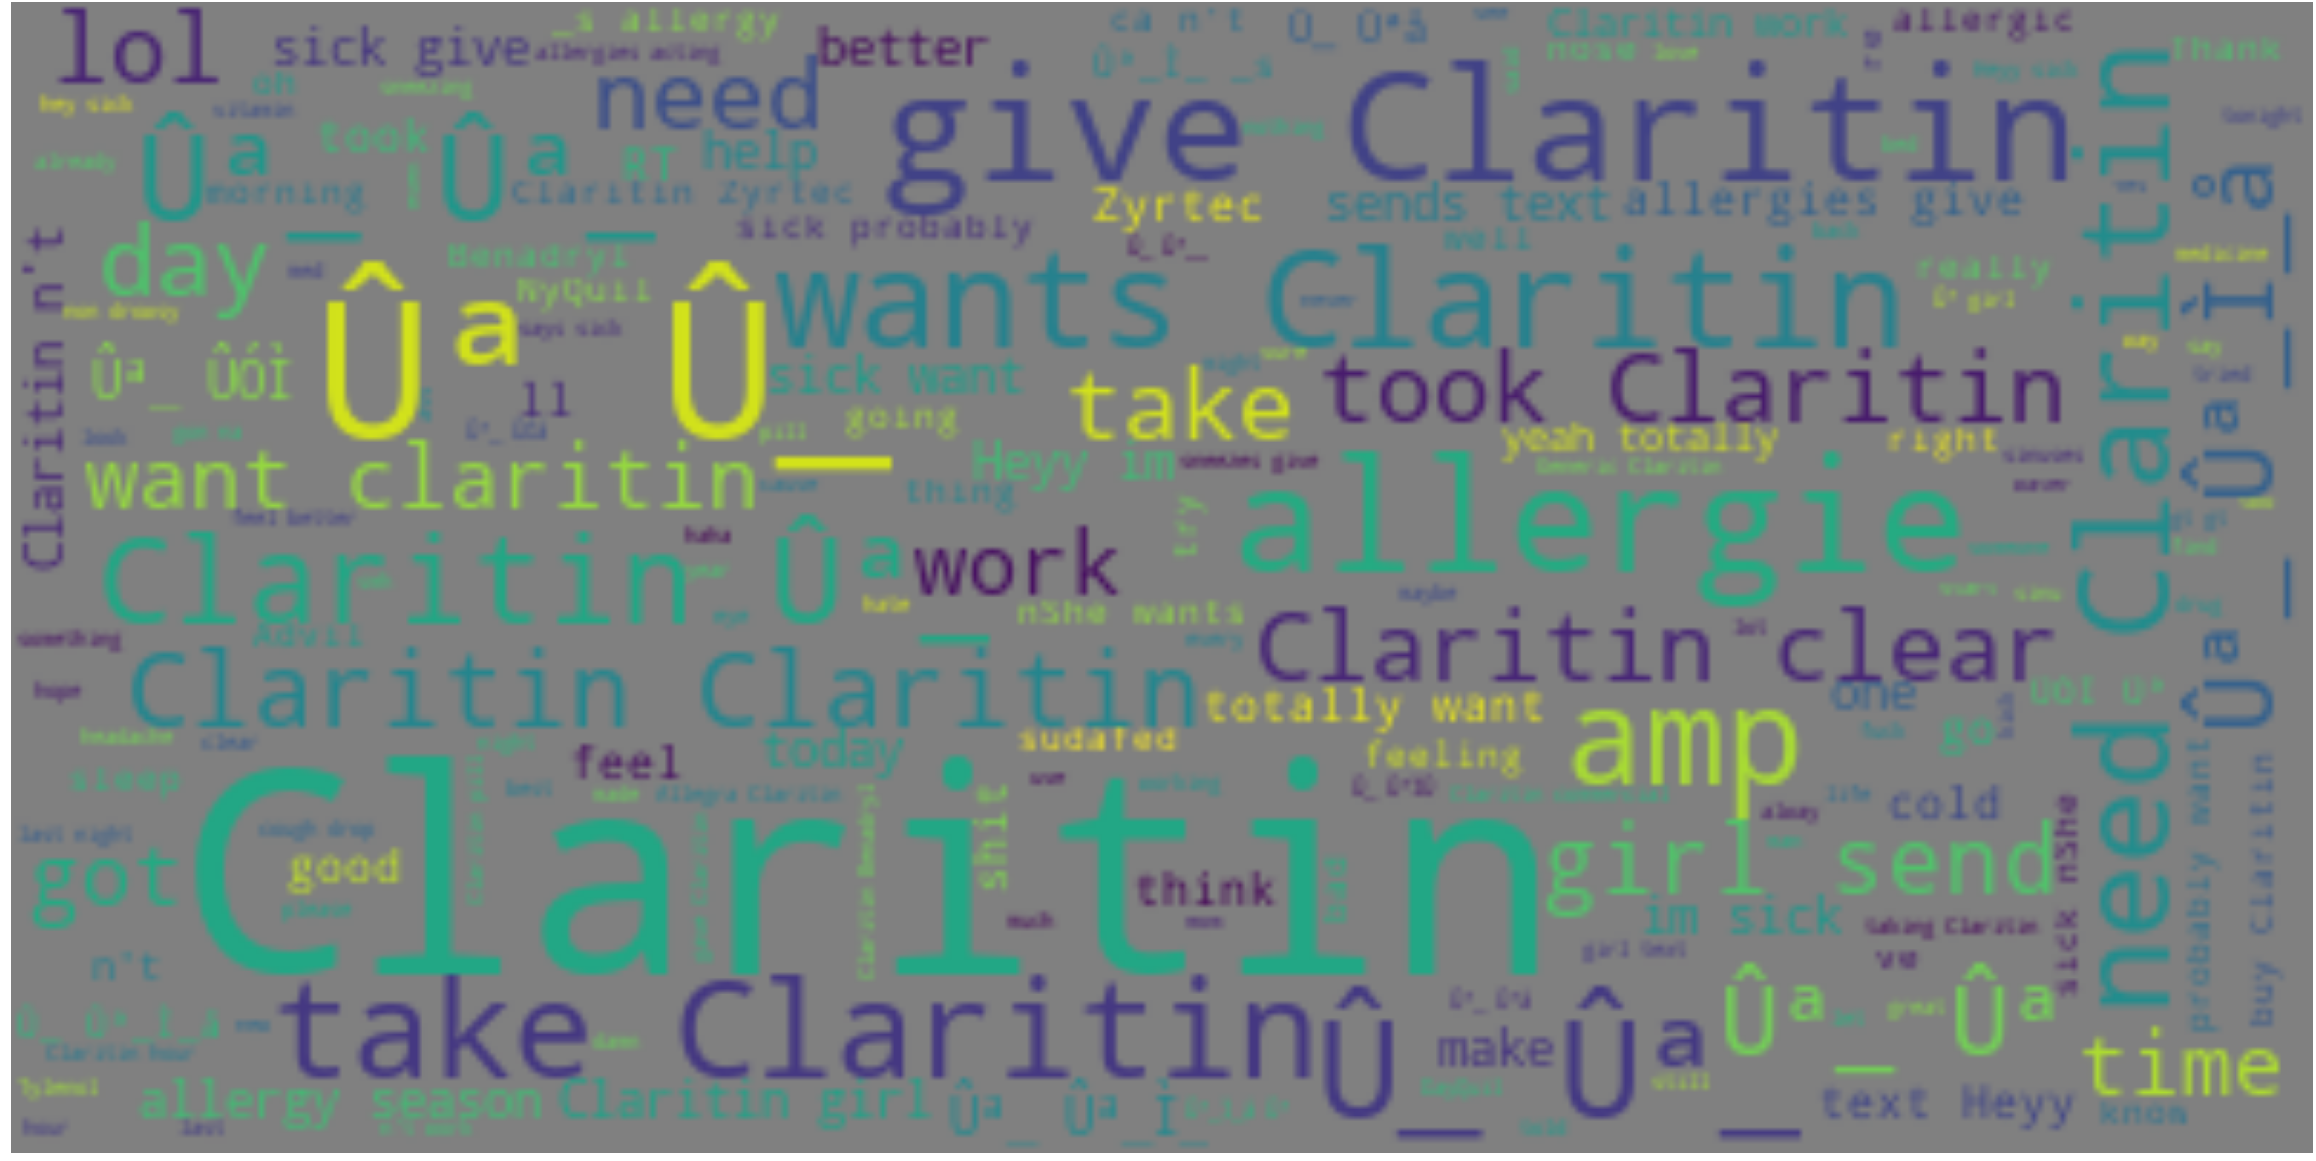
Step 3: Data Exploration & Visualization
1. Generate a sequence wordclound from the word

Slide 11
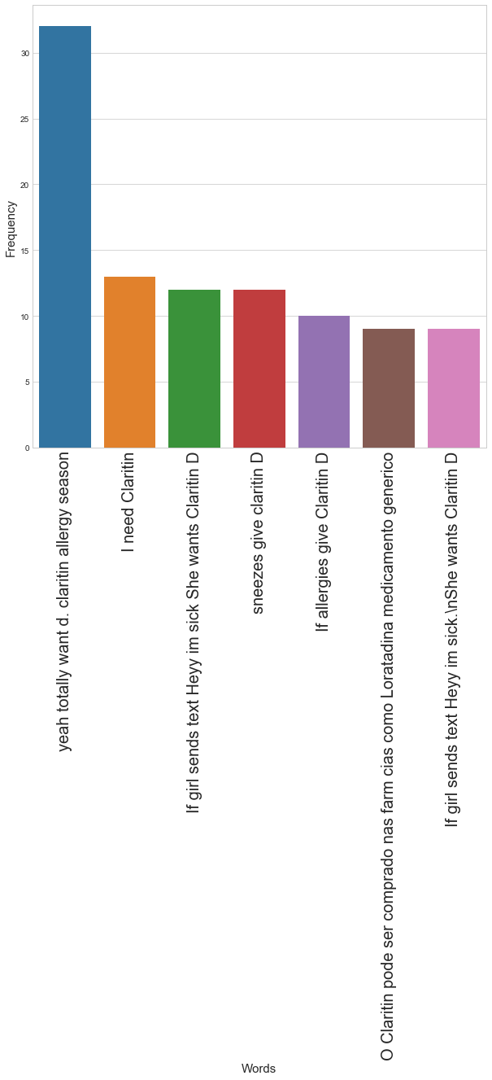
2. Most popular words at content column
a:

Slide 12
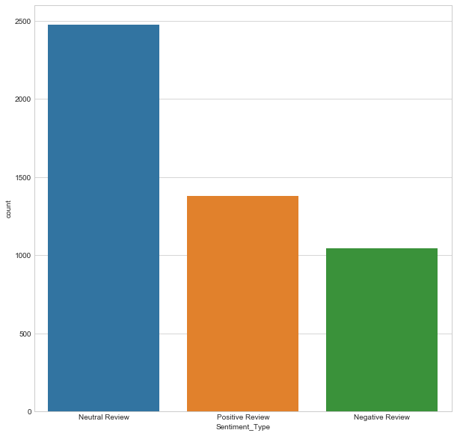
Sentiment function
of textblob

Slide 13
Step4:Modle build
1. Random Forest Classifier applied for model
The result of accuracy is 0.53
2. Multinomial Negative Binomul
The result of accuracy is 0.51

